Slide 1
Sterile Neutrinos in Neutrino Alley
“Please describe in broad brush how the sterile oscillation search could go and what reach might be achievable? Just a little more detail than we had today.”

Slide 2
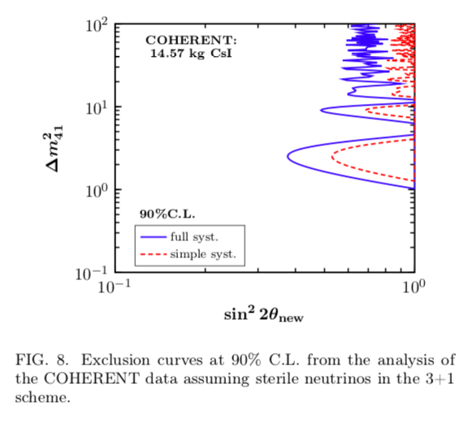
Interpretation of current CsI results:
I don’t quite
understand the
systematics treatment
for this paper,
and it’s not clear
if full spectrum is
used for this...
but clearly the
current constraint
is pretty weak

Slide 3
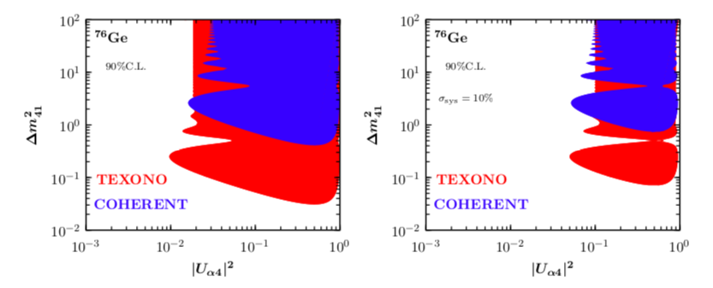
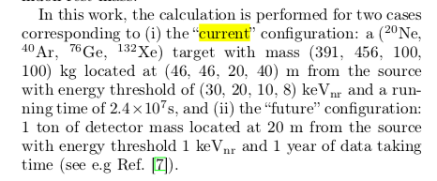
arXiv:1703.00054
Zero systematics is assumed
Assumptions:
!!!!
- one can cancel some systematics with multiple “identical” detectors (or movable detector)... but these are very large masses assumed...

Slide 4
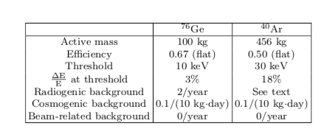
Phys.Rev. D86 (2012) 013004
Assumes (presently unavailable) two MW stopped-pion sources at 20 m and 40 m from 1 detector
... similar results for 1 source and 2 presumably “identical” (unrealistic) detectors
(the ~40 m one scaled for mass and/or running time)

Slide 5
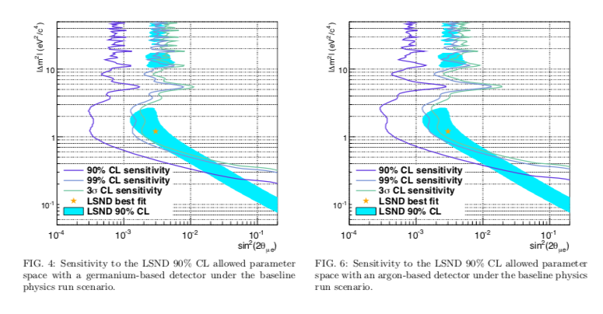
100 kg of Ge is not realistic...
Multitone of Argon is OK, but cross calibration of two LAr detectors down to 0.1% accuracy is not realistic. Daya Bay Detectors with strictly define FV has cross calibration of 0.13%

Slide 6
General comments on steriles with COHERENT
CEvNS is a new, attractive tool for sterile oscillations; NC disappearance is an especially clean signature
Would require ~ton, and likely multiple, detectors, plus careful systematics management
However, right at this moment it is not our highest priority; many experiments worldwide are going after this
COHERENT has other unique physics to explore
in the near term this would strain current Collaboration resources
The priorities could rearrange if a promising signal is seen in another experiment

Slide 7
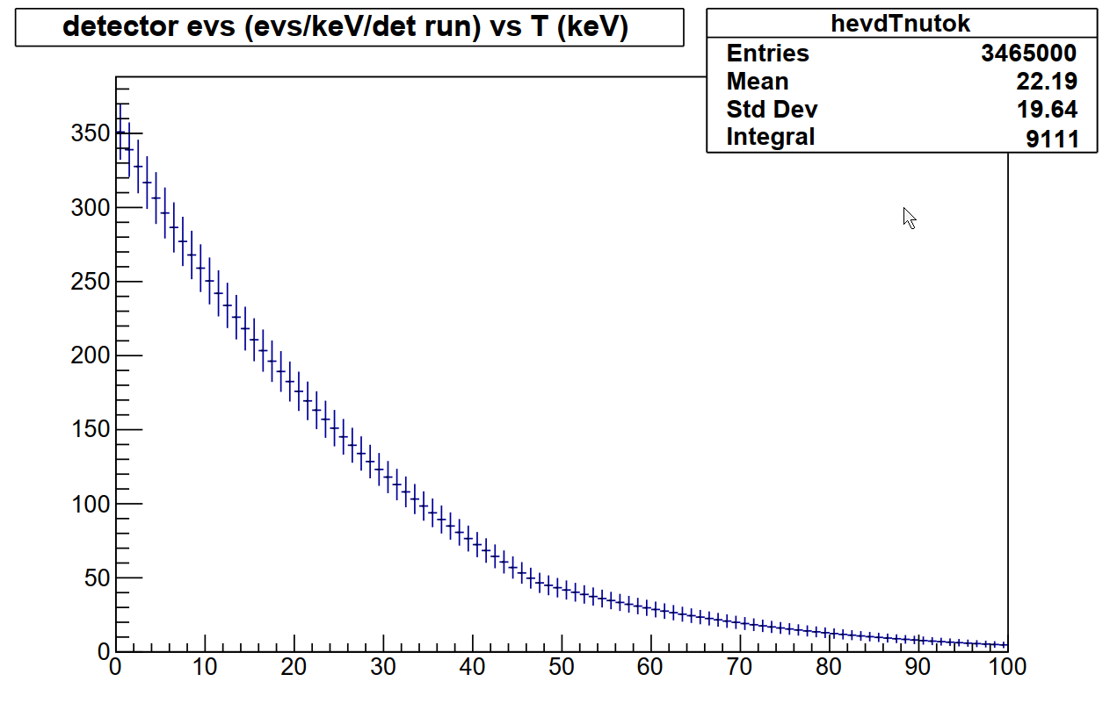
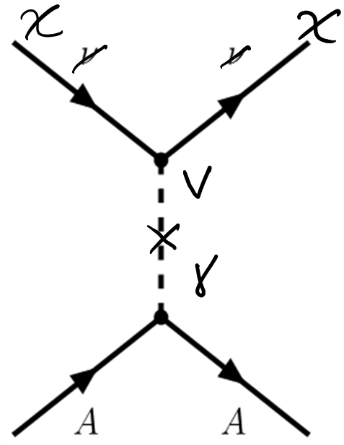
ORNL COHERENT review: Q2
“Please quantify the accelerator-produced dark matter search in terms of the production rate and the statistics of detection. Our interpretation of the Pospelov paper is that the pion decay branch is already excluded.”
Quick event sensitivity calculation (event counting only):
In O(1-ton) LAr: 4000/events/SNS year, Stat error: 60 events, sys error ~200 (5%) QF ⇒ ~250 event sensitivity to DM coherent scattering
Ar CEvNS recoil
Spectrum
For 750kg-1yr

Slide 8
Tonne-scale LAr for COHERENT
1 tone LAr detector is important part of overall COHERENT program to look BSM and untangle nuclear form factors. Envision future expansion for multitone detector(s)
Possible constrains on DM is a bonus.
Overview of 1t LAr detector:
Single phase LAr (scintillation-only) calorimeter,
Option is to use underground (low ³⁹Ar) argon
For deployed CENNS-10 (22 kg) detector we achieved; 5 PE/keV_{ee} for E_{thresh}~20keV_{nr} Expect the same for 1t detector
Light collection, default: TPB-coated PMTs (same percentage coverage as CENNS-10), TPB-coated Teflon side reflector.
Options under study:
SiPMs (same percentage coverage as CENNS-10),
VUV reflectors
Xe-doping of LAr for WLS, shorter excitation time
Shielding scheme as CENNS-10: Pb, Cu, H₂O. Will optimize.

Slide 9
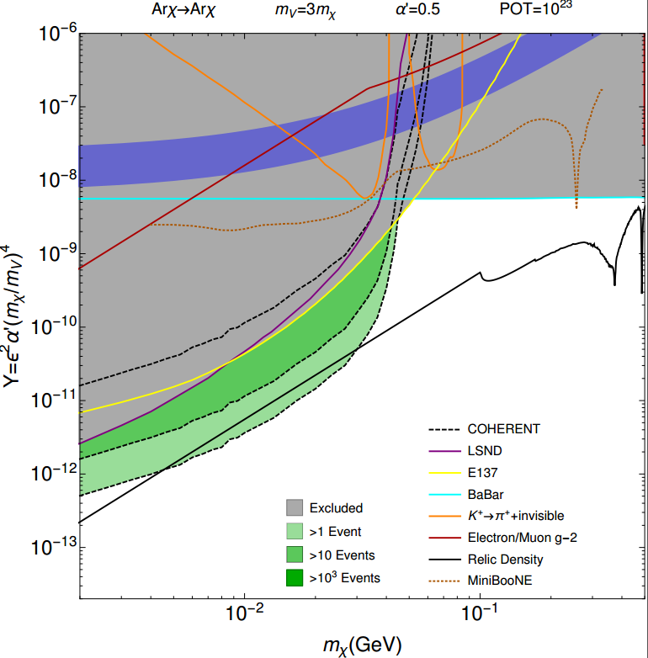
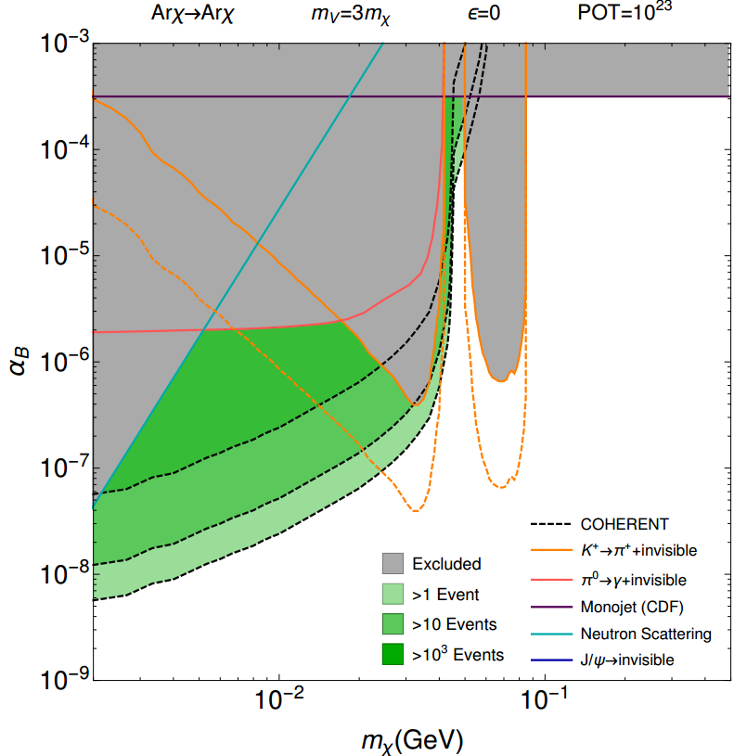
DM sensitivities with LAr in COHERENT
1 ton LAr, E>20keVnr, 1E23POT (2/3 yr).
1-1000 event sensitivity plots
predicted experimental sensitivities – work in progress
updated plots from
Patrick DeNiverville
vector portal
“dark photon”
model
baryonic ν “leptophobic” model

Slide 10
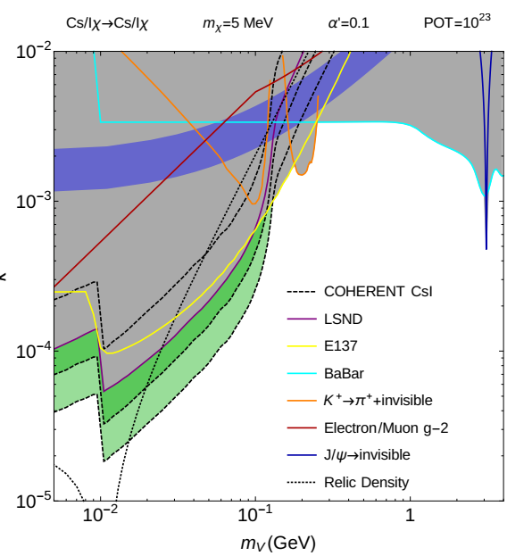
DM sensitivities with LAr in COHERENT
“Our interpretation of the Pospelov paper is that the pion decay branch is already excluded.”
This plot is a projection with Mχ = 5MeV. There is much more parameter space at higher Mχ , eg:

