Slide 1
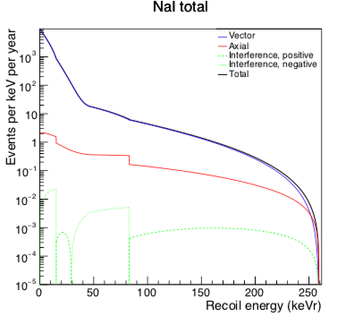
Axial contribution to the recoil spectrum
This assumes one
unpaired nucleon..
we need some nuclear
structure calculation
for a better prediction
(which can in principle
be tested...)

Slide 2
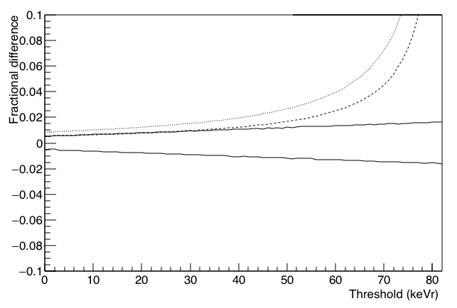
Fractional difference in rate over threshold
Prompt ν_{μ}
Na-23
Axial
contribution
*1.26²
Helm w/ Rn -3%
Axial
contribution
Helm w/ Rn +3%
Working on this: can add strange contribution, etc. stat uccty, etc

