Slide 1
Neutrinos: ORNL
PROSPECT, COHERENT AND NEW INITIATIVES
DOE High Energy Physics Review
September 6, 2018
A. Galindo-Uribarri
J. Newby, Y. Efremenko

Slide 2

Outline
ORNL HEP Opportunities
The Group
Projects
  PROSPECT
  COHERENT
  New Initiatives
Accomplishments
Future Plans
Summary

Slide 3
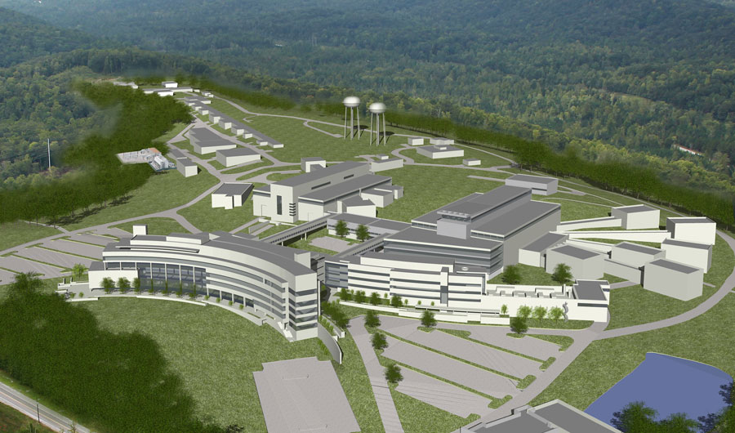
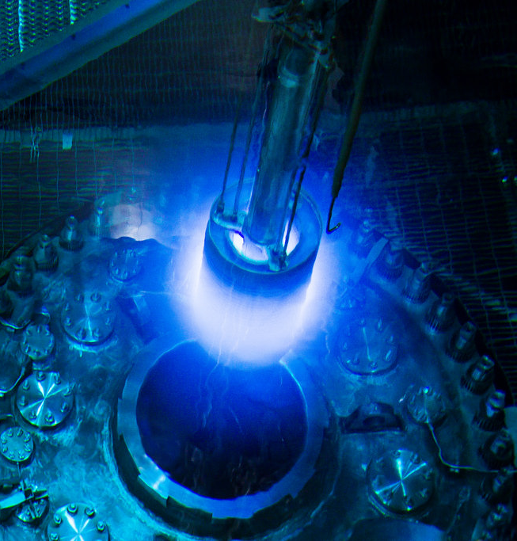
ORNL’s Opportunities: World Class Neutrino Sources
Spallation Neutron Source: SNS
Pulsed neutron source
1 GeV protons on Hg target
1.4 MW beam power
2nd target station
High Flux Isotope Reactor: HFIR
85 MW research reactor
Compact core
Highly-enriched uranium fuel

Slide 4
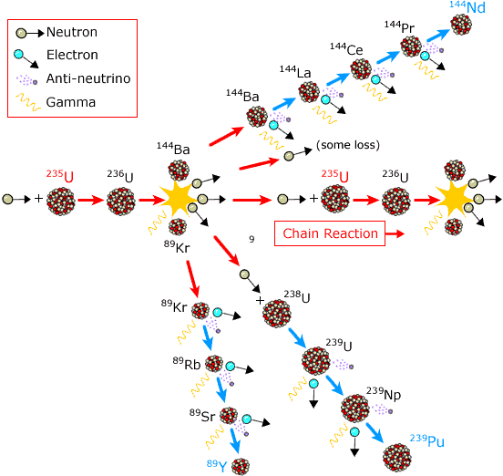
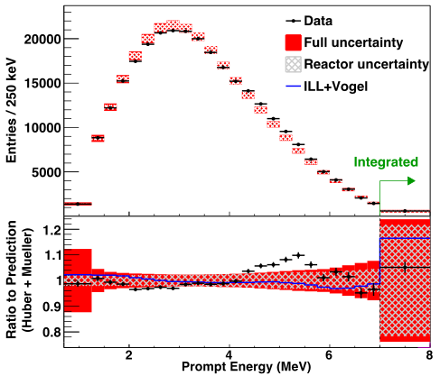
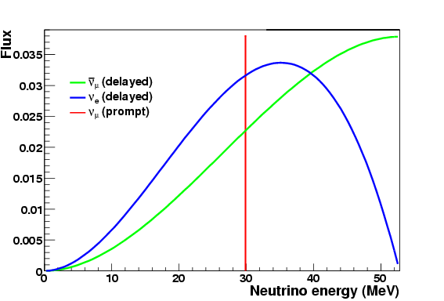
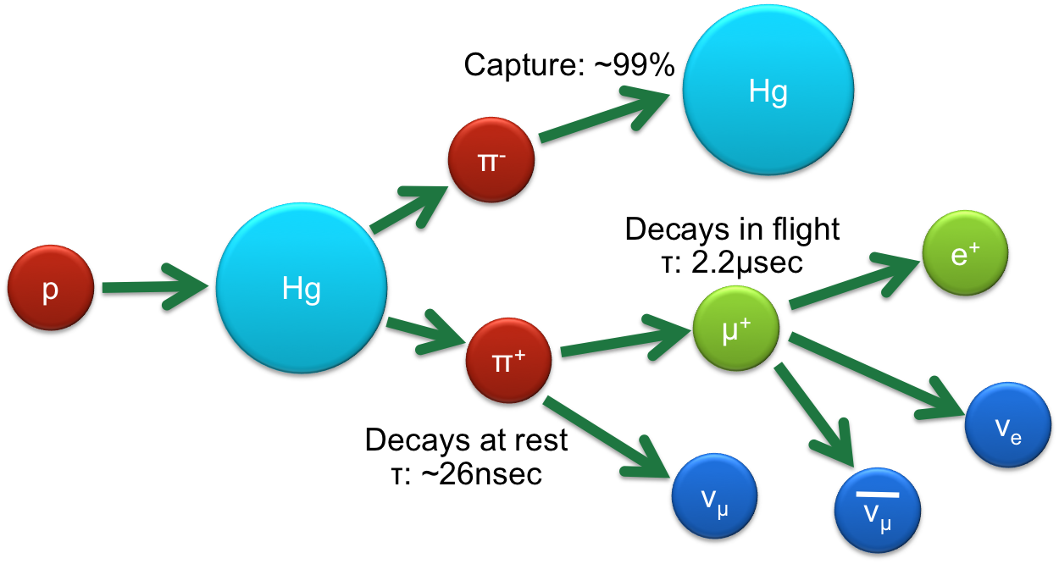
Neutrino flux origin and spectra
HFIR
Fission
Huge flux
Few MeV
No timing structure
Beta decay fission fragments (v_{e})
SNS
Spallation
Large Flux
Few tens-of-MeV, Sharply-pulsed timing Background rejection
Decays at rest
Pion-decay-at-rest neutrino source
Spallation

Slide 5
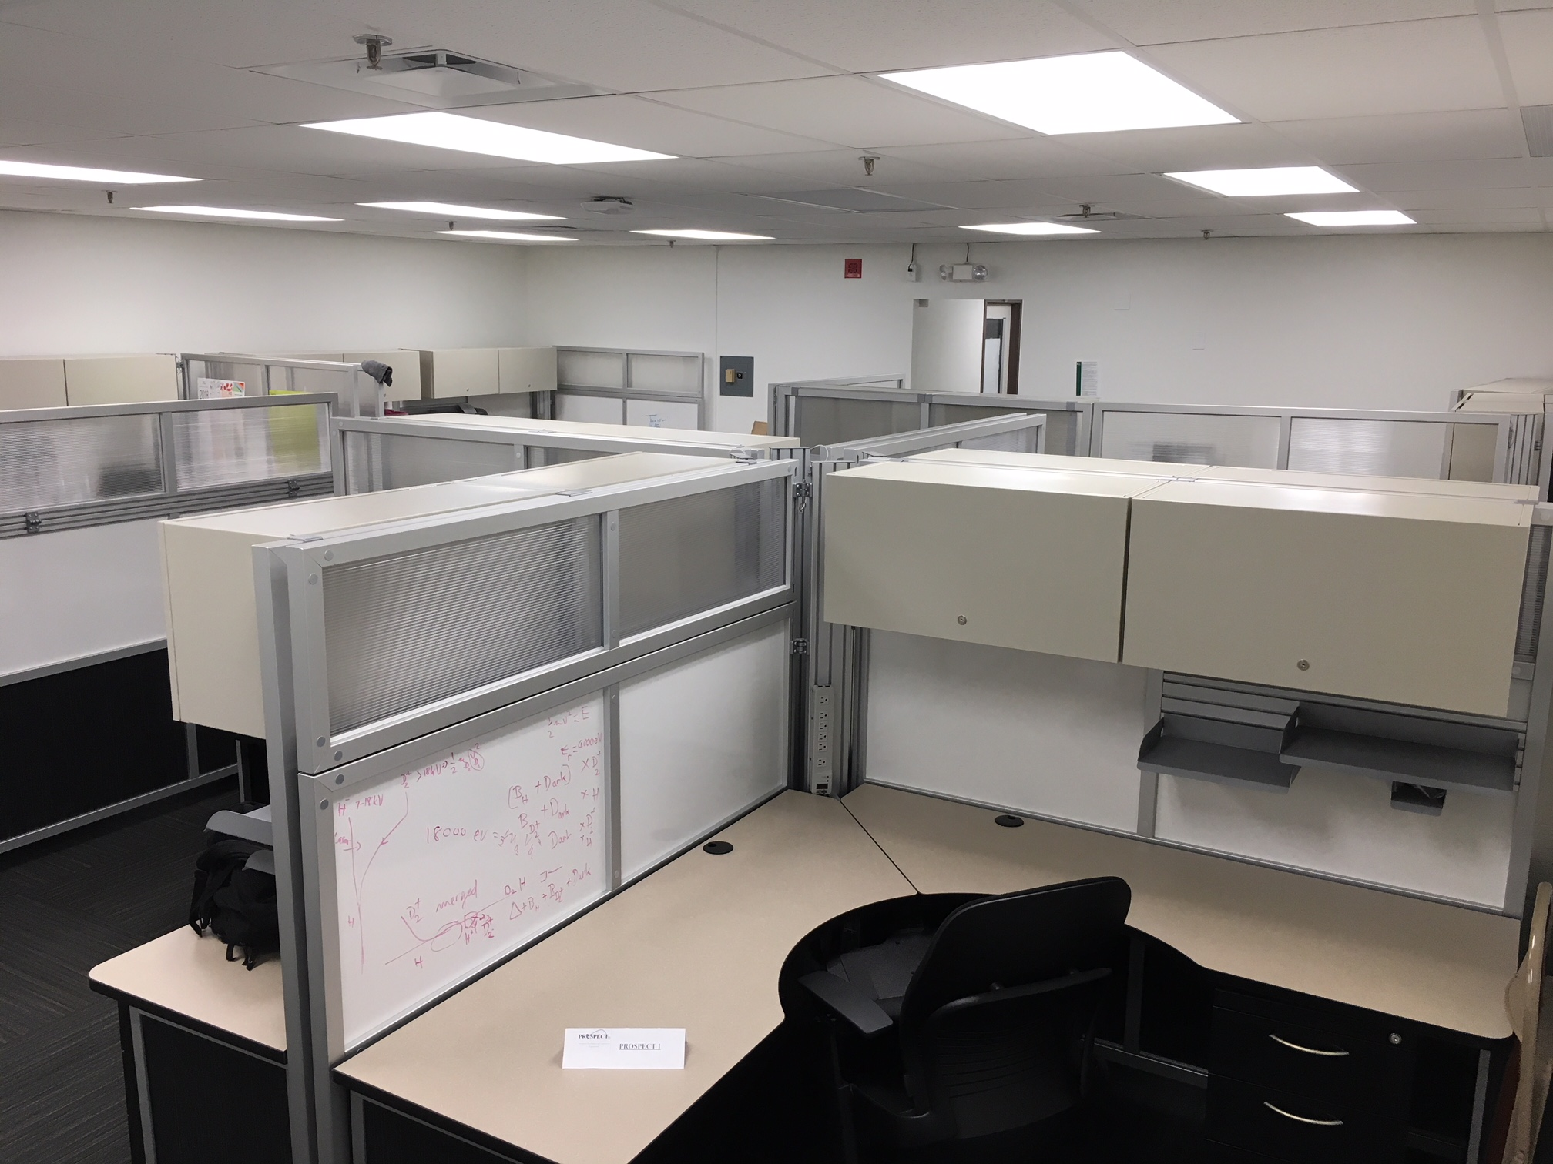
Other ORNL Resources:
The Oak Ridge Leadership Computing Facility
World class expertise in scientific computing
Computing and data analysis resources
Summit Supercomputer - World’s Fastest
Physics Division
Computer Cluster
Laboratory Space
High-bay area
Office and Meeting Space for Visitors
No-cost dormitories (JINPA)

Slide 6
Computational Sciences Activities Related to HEP
Pilot Programs on Quantum Information:
PI Name:
Raph Posser (led by Wisconsin) Quantum-enhanced detection of dark matter and neutrinos
Travis Humble (with JHU) Particle Track Recognition …
Travis Humble (with FNAL) HEP Machine Learning and Optimization
Multi-lab whitepaper to DOE/HEP on future HEP software needs
ORNL Physics Division will host a Workshop on mid-November 2018
Jack C. Wells, Director of Science, Oak Ridge Leadership Computing Facility

Slide 7
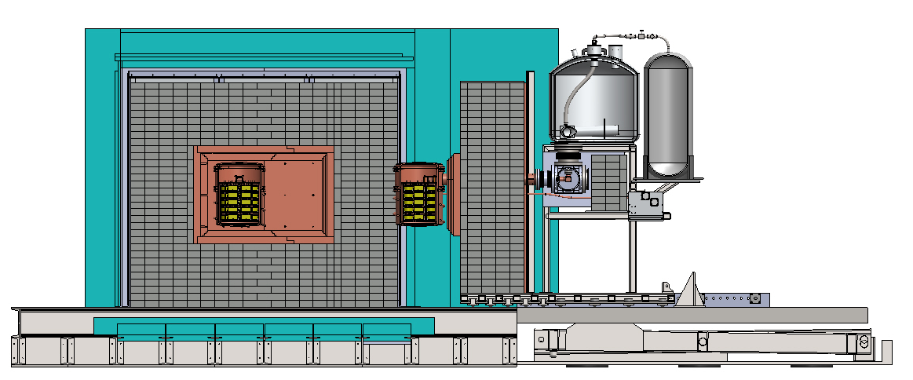
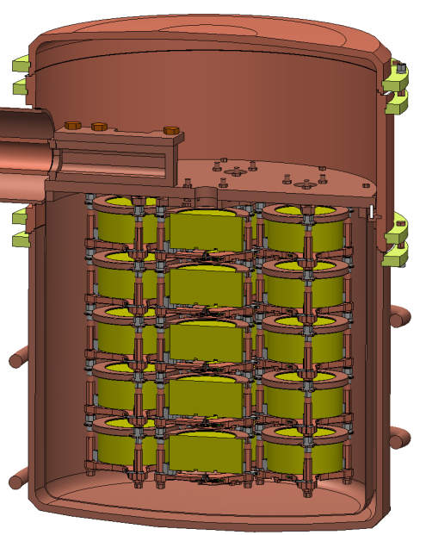
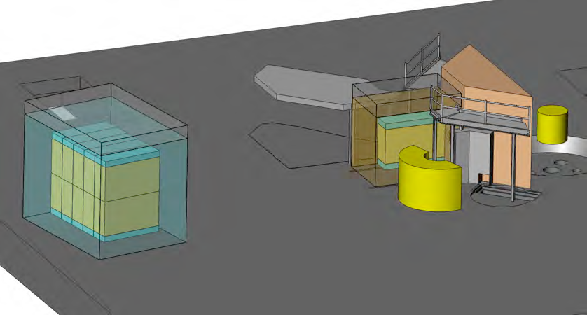
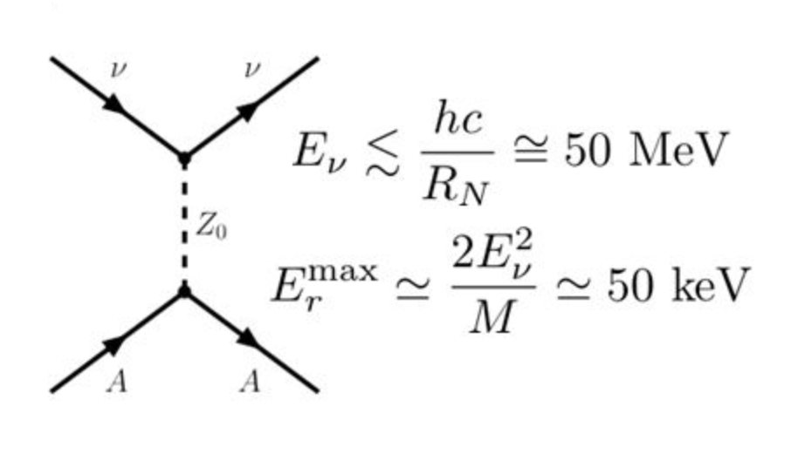
Current ORNL interests on neutrino physics
The Majorana Demonstrator (MJD)- A ⁷⁶Ge 0νββ experiment at SURF
LEGEND 200/ LEGEND 1000- towards 1 tonne ⁷⁶Ge experiment
  PROSPECT- A Precision Reactor Neutrino Oscillation and Spectrum Experiment at the 85MW HFIR
COHERENT- Coherent elastic neutrino-nucleus scattering using the neutrino emissions from the SNS spallation source at ORNL

Slide 8
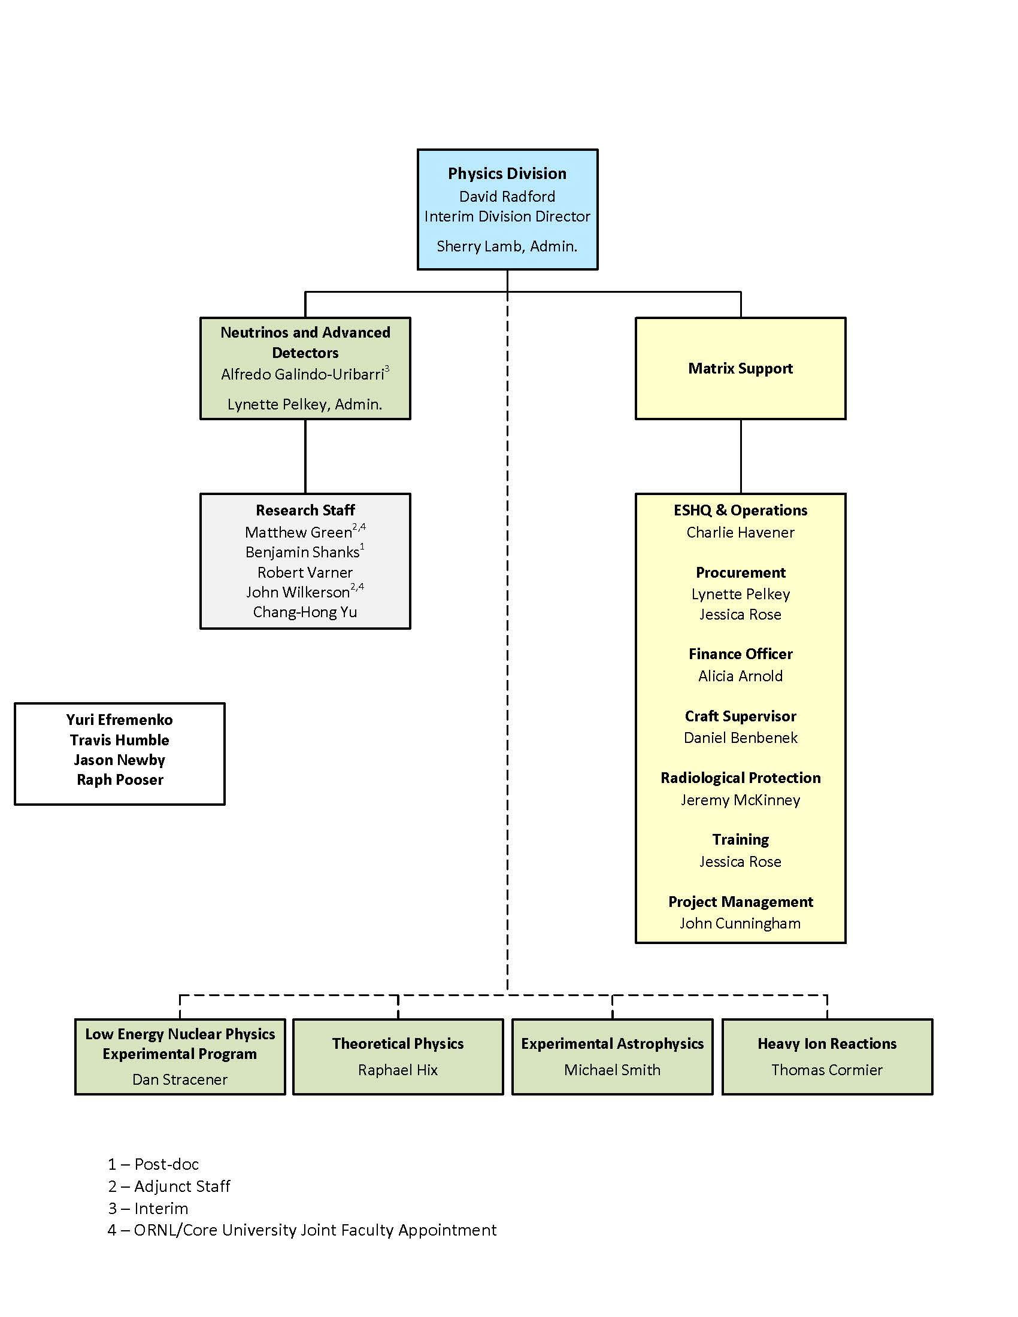
The Group
Projects
  Majorana Demonstrator
  LEGEND
R&D Accomplishments
  Majorana Demonstrator
  LEGEND
Research Plan
Summary

Slide 9
Physics Goals
Pursuing a broad research program in nuclear, particle, and astrophysics
emphasis on weak interactions and fundamental interactions.
The research program of the Physics Division includes:
studies of neutrino oscillation
neutrino properties
neutrinoless double beta decay.
The initial success of this program is enabling the discussion of new ideas for future collaborations.​
”P5” Report
Particle Physics Project Prioritization Panel

Slide 10
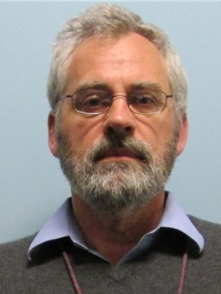
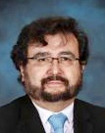
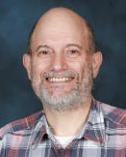
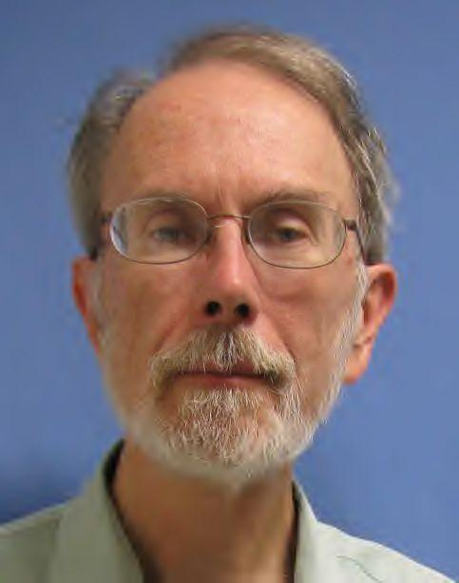
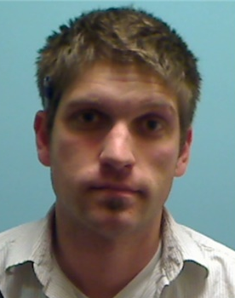
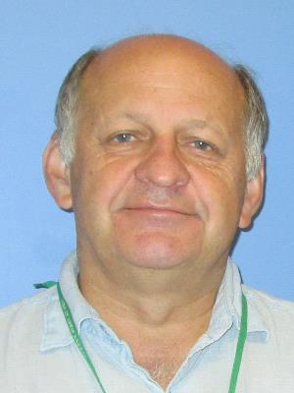
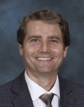
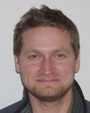
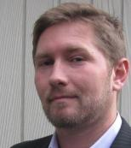
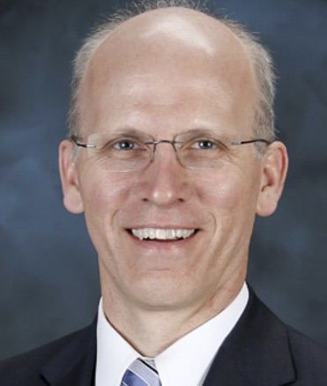
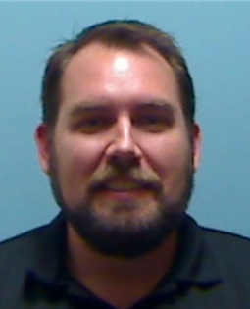
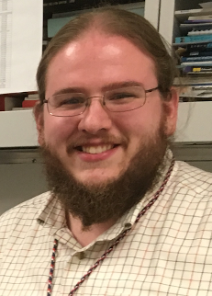
People
Research Staff
  D. Radford (Acting Division Director)
  A. Galindo-Uribarri (Acting Group Leader)
  P. Mueller
  R. Varner
  M. Febbraro (FY2018 hire; LDRD)
  J. Newby (Nuclear Sci. & Eng.)
  R. Pooser (Computational Sciences)
  T. Humble (Director Quantum Computing Institute)
  J. Wells (Director Science NCCS)
  Joint Faculty
  Yu. Efremenko (UTK)
  M. Green (NCSU / TUNL) (Wigner Fellow 2013 - 2015)
  PostDocs
  J. Matta

Slide 11
Background and Expertise
Senior research staff come from backgrounds in nuclear structure and reactions physics
  Extensive experience with Ge detector technologies, scintillators, particle detectors
  Joined PROSPECT and COHERENT in 2012
Hardware: Detector systems, vacuum, data acquisition, low-background shielding, …
Software: Data acquisition, data analysis, deep learning, …
Project management
Scintillator chemistry and synthesis

Slide 12

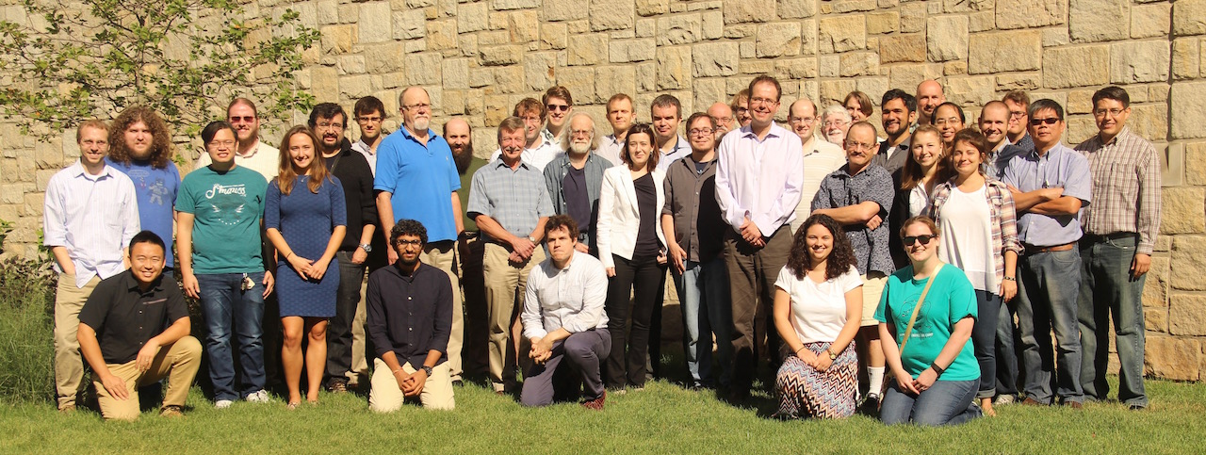

















PROSPECT Collaboration
Supported by:

Slide 13
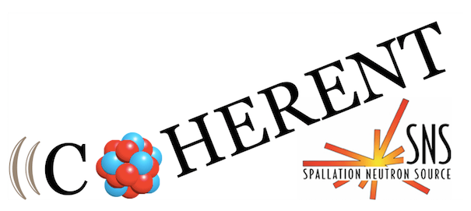
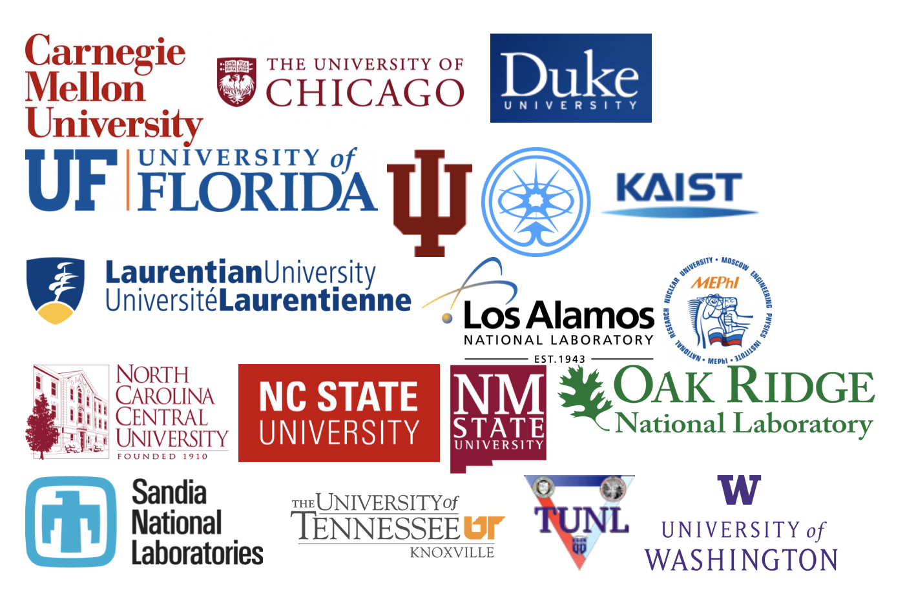
COHERENT Collaboration

Slide 14
PROSPECT and COHERENT train high quality young scientists
Blaine Heffron, Physics Graduate Student from University of Tennessee, Knoxville, M.Sc. 2017: “Characterization of Reactor Background Radiation at HFIR for the PROSPECT Experiment” represents the FIRST thesis of the PROSPECT
Brennan Hackett, Physics Graduate Student from Surrey, UK, M. Phys. 2017: “DANG and the Background Characterisation of HFIR for PROSPECT”, SECOND thesis of PROSPECT
Jack Boyle, Physics Graduate Student from Surrey, UK, M. Phys. 2018: “Characterising the Effects of Ambient Magnetic Fields on Photomultiplier Tubes and Monitoring Muon Flux for PROSPECT”, THIRD thesis of PROSPECT
Bjorn Scholz, Physics Graduate Student from U. of Chicago, Ph.D. 2017: “First Observation of Coherent Elastic Neutrino-Nucleus Scattering”, FIRST thesis of COHERENT
Grayson Rich, Physics Graduate Student from Duke University, Ph.D. 2017: “Measurement of Low-Energy Nuclear-Recoil Quenching Factors in CsI[Na] and Statistical Analysis of the First Observation of Coherent, Elastic Neutrino-Nucleus Scattering”, SECOND thesis of COHERENT

Slide 15
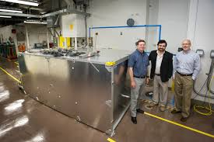
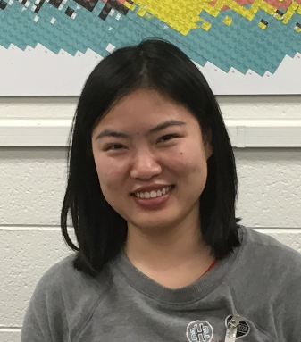
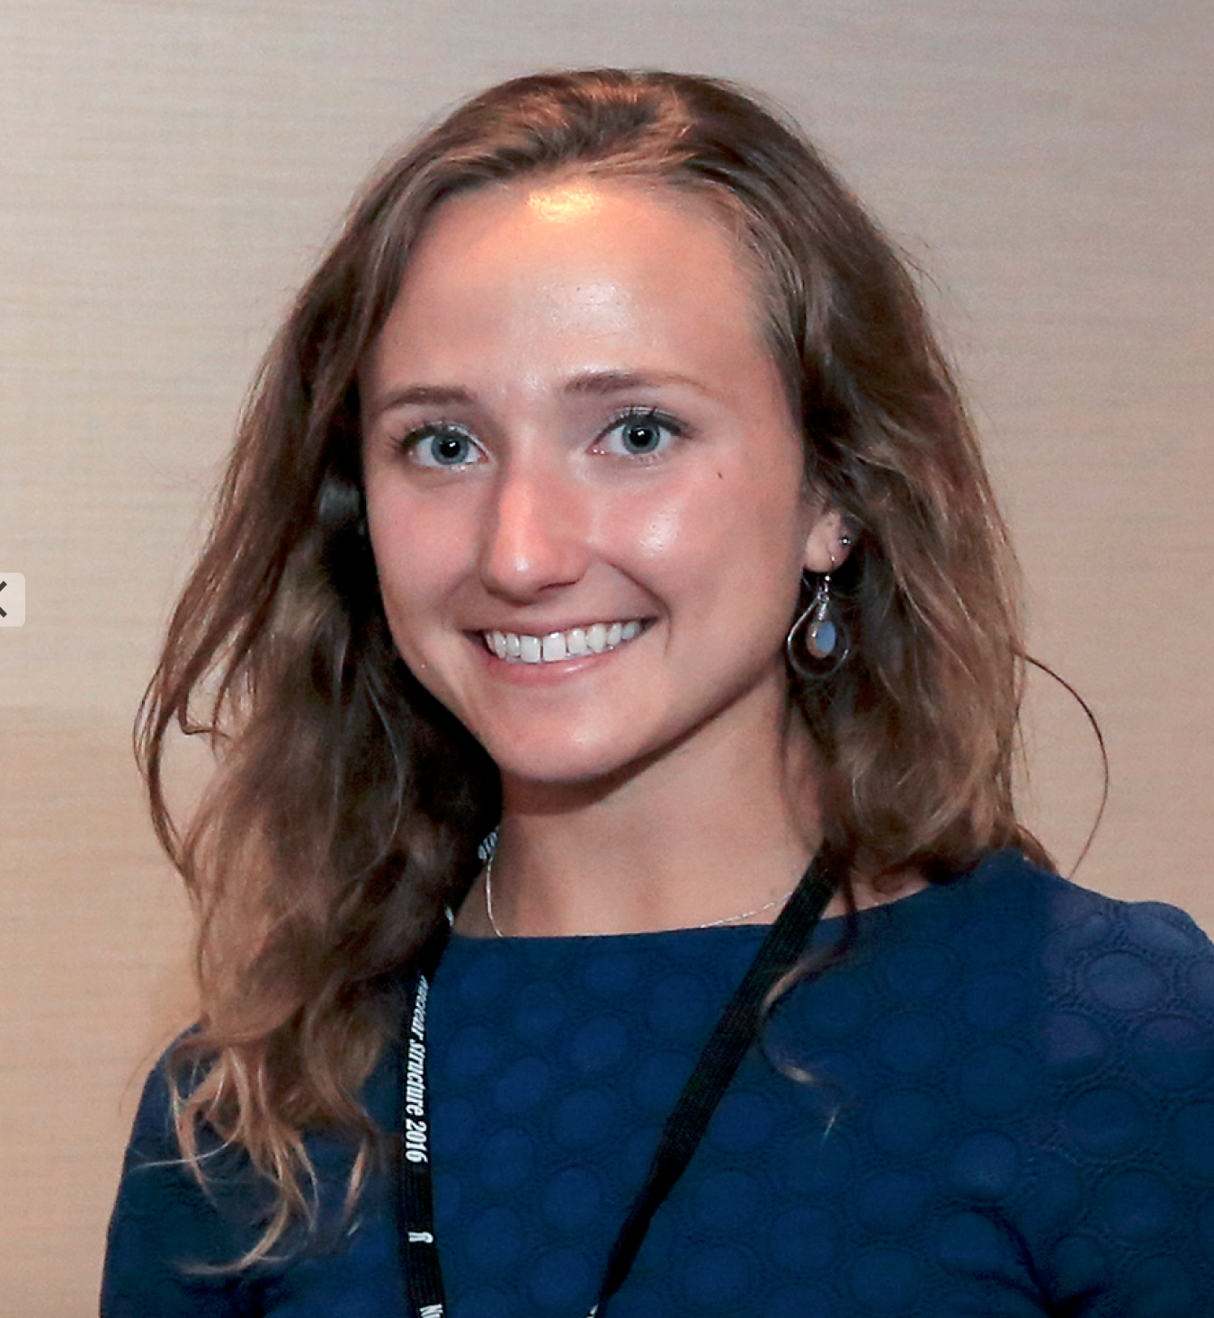
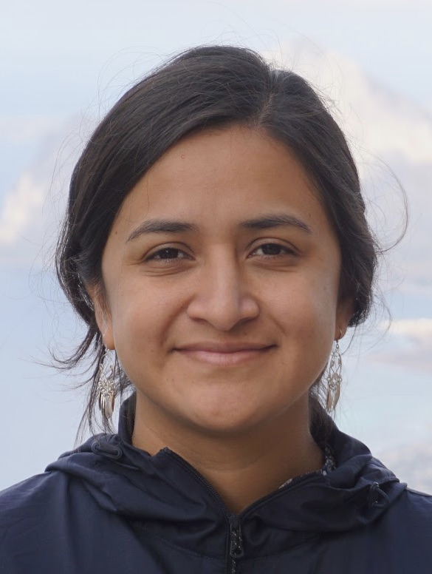
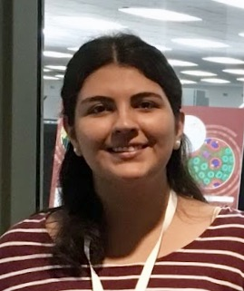
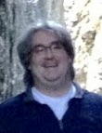
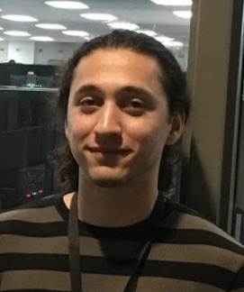

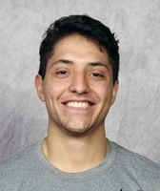
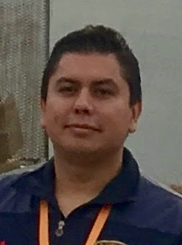
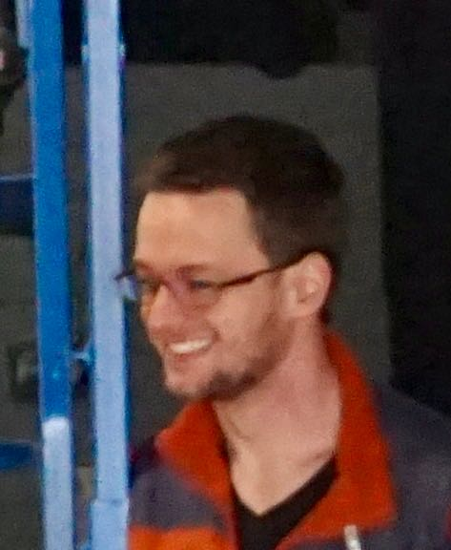
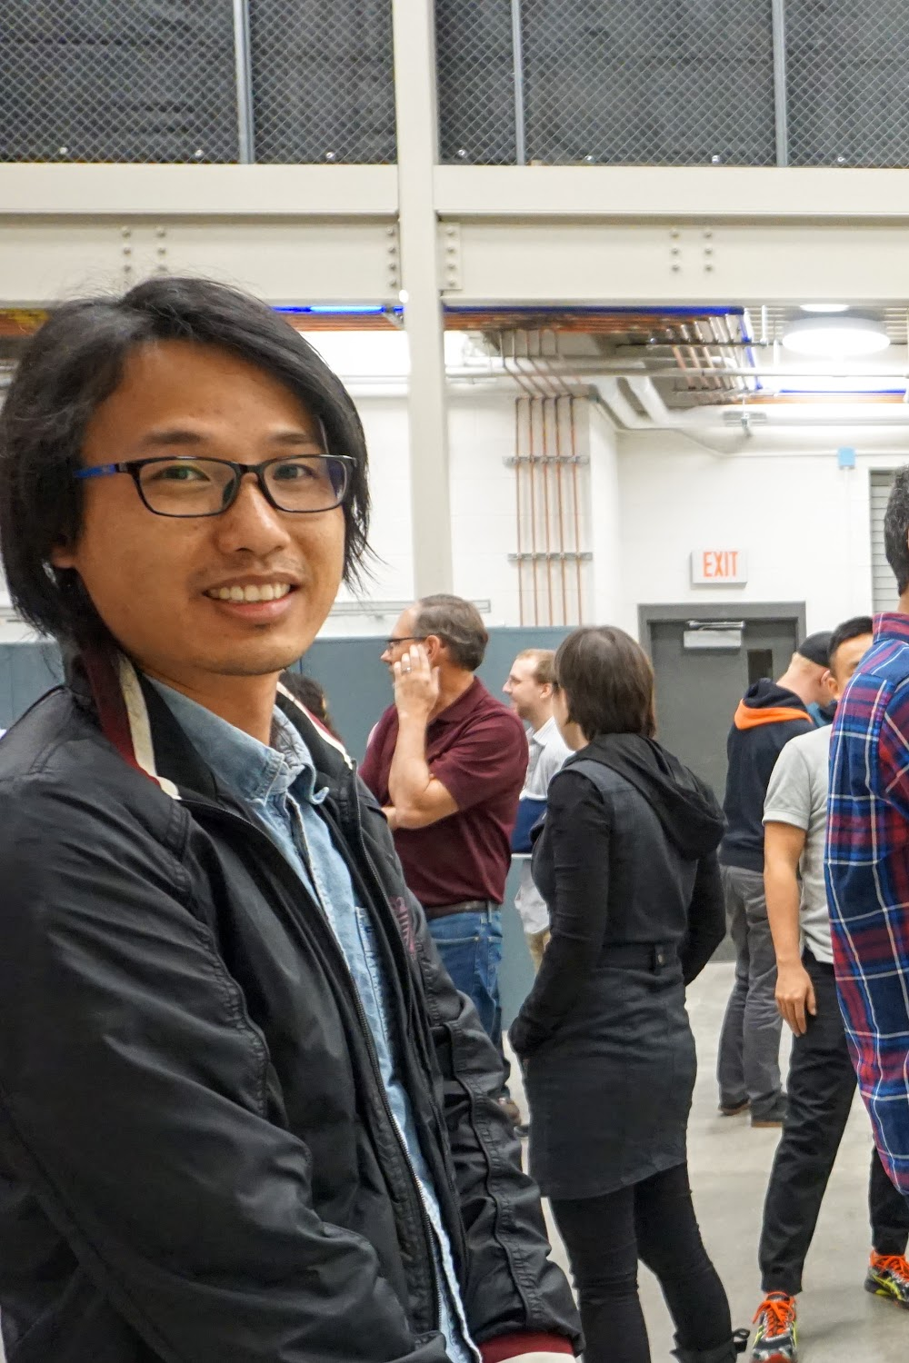
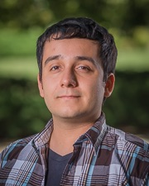
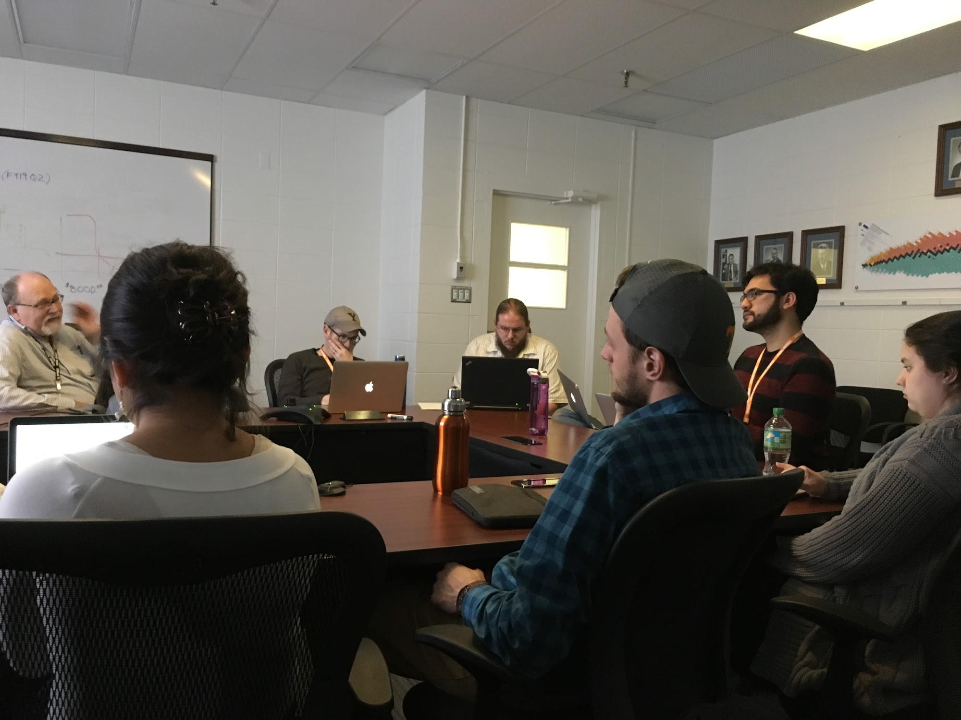
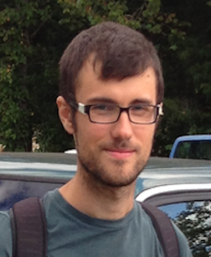
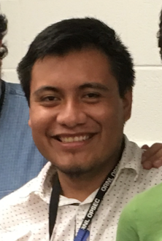
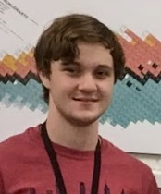


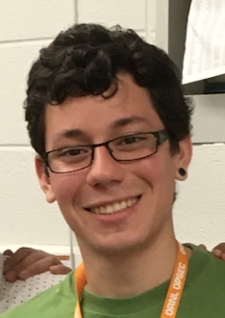
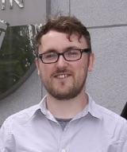
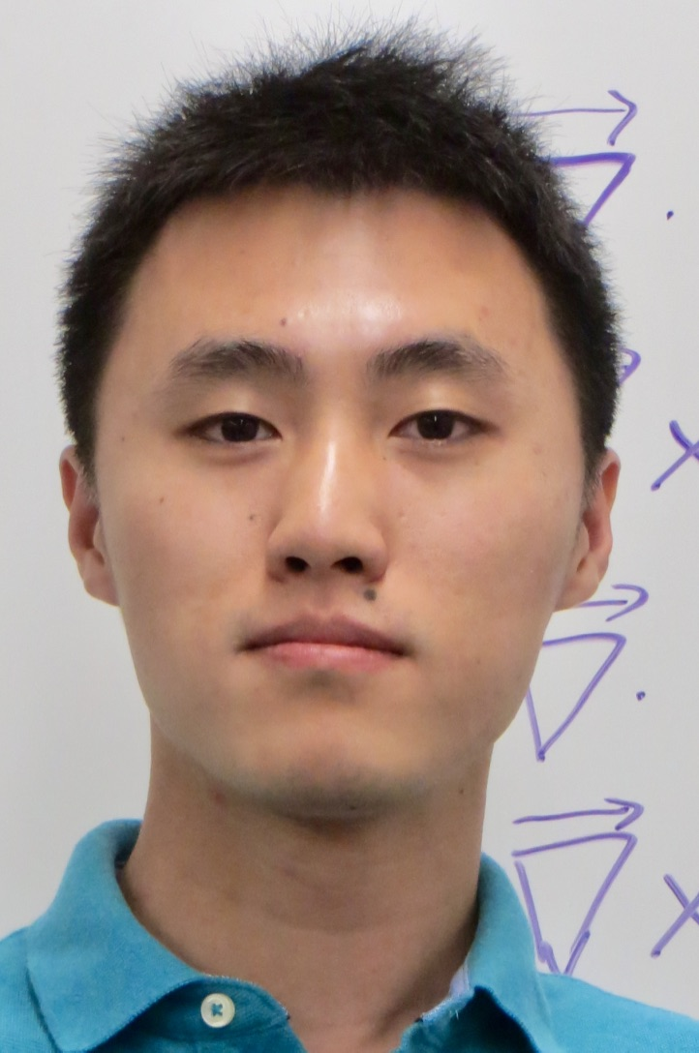
Students and Postdocs that worked in PROSPECT
Ran
Chu
UTK
Brennan Hackett
UTK
Elisa Romero
UTK
Rosa Luz Peinado
Sonora
James
Matta
ORNL
Brandon
White
ORNL
Alex
Guirado
Sonora
Alan
Garcia
UTEP
Diego
Vargas
Wesleylan
Ivan
Corona
UAEM
Corey Gilbert
UTK
Xiaobin
Lu
UTK
Cristian
Baldenegro
Sonora
Blaine Heffron
UTK
Noel
Cruz
UNAM
Jack
Boyle
Surrey
Travis Stockinger
UTK
Biswas
Sharma
UTK
Felix Pastrana
Colombia
David Murphy
UCD
Shiyu Fan
UTK
+ 28 more from collaboration institutions

Slide 16
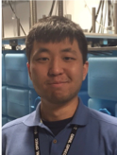
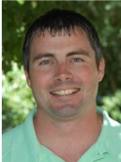
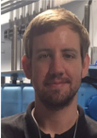
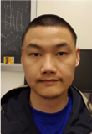



















Students and Postdocs that worked in COHERENT
Ben Suh
IU
Justin Raybern Duke
Sam Hedges
Duke
Long Li
Duke
Alexander Kumpan, MEPhI
Brandon Becker
UTK
Jacob Zettlemoyer IU
Connor Awe Duke
Katrina Miller
Duke
Hector
Moreno
UNM
Dmitry
Rudik
MEPhI
Rebecca
Rall
CMU
Jes Koros
Duke
Alexander
Kavner
Chicago
Alexey
Konovalov
MEPhI
Matt Heath
IU
Alex Khromov
MEPhI
Gleb Sinev
Duke
Erin Conley
Duke
Dan Salvat
UW (Postdoc)
Jacob Daughhetee
UTK
(Postdoc)
Mayra Cervantes
Duke (Postdoc)
Ivan Tolstukhin
IU (Postdoc)
Josh Albert
IU (Postdoc)
First two PhD dissertations completed
Bjorn Scholz
U of Chicago
Grayson Rich
Duke

Slide 17

ORNL provides strong support for Neutrino Program
PROSPECT Collaboration with ORNL personnel at HFIR

Slide 18





A Precision Oscillation and Spectrum Experiment

Slide 19

PROSPECT Complete
PROSPECT is a reactor neutrino experiment at very short baselines to make a precision measurement of the flux and energy spectrum of antineutrinos emitted from nuclear reactors. PROSPECT will search for the oscillation signature of sterile neutrinos. The measurements of PROSPECT will test our understanding of the Standard Model of Particle Physics, deepen our understanding of nuclear processes in a reactor, and help develop technology for the remote monitoring of nuclear reactors for safeguard and non-proliferation. ORNL had key roles on the installation and commissioning.
Funding sources:
DOE Office of Science, Office of High Energy Physics
Heising-Simons Foundation
Resources:
Physics Division, HFIR

Slide 20
ORNL - PROSPECT
ORNL group has provided strong support for PROSPECT, significant contributions to the experiment, infrastructure, on-site logistics, safety, and supervision of students.
Excellent training ground for young scientists (first 3 thesis).
Key roles in the installation and commissioning of PROSPECT.
Increase our participation in the antineutrino spectrum analysis effort, and to provide laboratory support to improve the overall performance (e.g. shielding hot spots, magnetometers for residual field monitoring, etc.)
Key role in operations, data taking, calibrations, shift coordination, etc.
Continue background studies in surface neutrino detector
Measure and understand the ²³⁵U reactor antineutrino spectrum

Slide 21




Detector Installation
Temperature control and thermal shielding
Moving ISOtank from PD to HFIR
Coordination with Yale

Slide 22


6LiLS QA/QC
UV-Vis spectra of individual LiLS drum samples compared with the ISO-tank sample

Slide 23
Immediate Goals for PROSPECT
Reactor-model independent search for sterile neutrinos at the eV-scale
Measure and understand the ²³⁵U reactor antineutrino spectrum
Started taking data since March 2018
Detected neutrinos from HFIR
First oscillation analysis (submitted to PRL) – complete
First spectrum analysis in progress
Updated oscillation + spectrum results
Joint analysis with other experiments
Backgrounds in surface neutrino detectors

Slide 24

World Wide Efforts to Detect CEvNS

Slide 25

SNS as a neutrino source
World most powerful pulsed neutrino source; 7・10²⁰ POT daily
~9% of protons produce 3 neutrinos
Neutrino energies ideal to study CEvNS and Supernovae related neutrino cross sections.
For most of neutrinos E_{ν} < 53 MeV
Decay At Rest from pions and muons (DAR) gives very well defined neutrino spectra
Fine duty factor let suppression of steady background by a factor of 2000.
    ~ 1000 m.w.e underground
Neutrinos, space, and utilities are provided

Slide 26


Coherent Elastic neutrino-Nucleus Scattering (CEvNS)
A neutrino scatters on a nucleus via exchange of a Z, and the nucleus recoils as a whole;
coherent up to E_{ν}~ 50 MeV
D.Z. Freedman PRD 9 (1974)
Submitted Oct 15, 1973
V.B.Kopeliovich & L.L.Frankfurt
JETP Lett. 19 (1974)
Submitted Jan 7, 1974
CEvNS cross-section is large!
CEvNS cross section is well calculated in the Standard Model

Slide 27




First Detection of CEvNS
Hand held neutrino detector
09/15/2017
Energy
Time
16 Month of data

Slide 28
Ongoing Activities in “Neutrino Alley”
“Neutrino Alley” at SNS basement with protection from SNS produced neutrons and hadronic component of cosmic rays.
Taking data with 22 kg LAr detector.
Advanced analysis stage.
Taking data with 185 kg NaI detectors.
Study of neutron backgrounds. MARS commissioning and calibration.
Taking data with CsI(Na).
Study of v Induced Neutrons on Pb and Fe.
upgrade using PROSPECT LiLS

Slide 29

Immediate Goal for COHERENT
Test of the Standard Model prediction of proportionality of the CEνNS cross section to neutron number squared.
10 kg germanium (Ge) detector
2.0 tonne sodium iodide (NaI) detector
1.0 tonne liquid argon (LAr) detector
1.3 tonne heavy water (D2O) detector
Measure CEνNS
Calibrate neutrino flux
D₂0
1.3 ton

Slide 30


Future Physics for COHERENT
We need large detectors with various targets
to untangle effects of nuclear form factors
Large statistics with accurate measurements of recoil spectra:
Non-Standard 𝑣 Interactions:
Test of the SM, DM
Nuclear Physics
Form Factors, Axial Currents
Supernovae Cross Sections and E_W Measurements
Supernova 1987a
Charm 1984
COHERENT 2017
J.R. Wilson, PRL 32, 849 (1974)
C. Horowitz et al., PRD 68, 02005 (2003)

Slide 31
COHERENT Director’s Review – August 15-16, 2018
COMMITTEE:
Baha Balantekin - Wisconsin-Madison
Jonathan Link - Virginia Tech
Gail McLaughlin - North Carolina State
Hamish Robertson – U. of Washington
“The SNS provides a source of decay-at-rest neutrinos that is unique in the world, in its intensity and time structure.”
“Extraordinarily important and long-sought achievement, the detection of coherent neutrino scattering from a nucleus.”
“Great example of the wisdom of P5’s Recommendation 4, to “Maintain a program of projects of all scales, from the largest international projects to mid- and small-scale projects.”
“A compelling and unique scientific program at SNS. The experimental …could lead into further new physics in a cost effective way.”

Slide 32
High Visibility PROSPECT and COHERENT- Publications and Conferences
Observation of coherent elastic neutrino-nucleus scattering, D. Akimov et al. Science, August 3, 2017, (82 citations)
First search for short-baseline neutrino oscillations at HFIR with PROSPECT, J. Ashenfelter et al., arXiv:1806.02784v3 [hep-ex], submitted to PRL
The PROSPECT Reactor Antineutrino Experiment, J. Ashenfelter et al., submitted to Nuclear Instruments and Methods August 2, 2018
Performance of a segmented 6Li-loaded liquid scintillator detector for the PROSPECT experiment, J. Ashenfelter et al 2018 JINST 13 P06023
Participation on Major Conferences and Workshops (Neurinos 2018, INT181a, Eclipse, Hawaii APS/JPS, …)

Slide 33
Summary – New Opportunities of Neutrino Physics at ORNL
World class resources: HFIR, SNS and Leadership Computing Facility
Strong group with deep expertise in projects, detectors, and experimental techniques
Unique cost-effective scientific program with 2 shallow-depth experiments
Collaborations involve more than 130 scientists from 30 institutions
Excellent training ground - More than 75 students and postdocs have been involved
Strong support from ORNL Physical Sciences Directorate, HFIR and SNS
PROSPECT successfully completed and taking data (Reactor_on – Reactor_off)
First observation of CEvNS
First results published in high-profile publications (Science, PRL)
Have an effective research plan to build on that success

Slide 34
Backup Slides

Slide 35

HFIR a Research Reactor operating at 85 MW as an intense point-like source of neutrinos
448 cycles X 540 fuel plates = 241,920 fuel plates without a failure.
Excellent design and quality control by the fabricator.
171
Fuel
Plates
~17”
Flux
Trap
Region
369
Fuel
Plates
Compact core of HEU fuel

Slide 36


PROSPECT Motivation
Directly test the hypothesis of a new oscillation with Δm2 ~ 1 eV²,
i.e. oscillation length of few meters
Provide new tests of reactor models by making precision measurements of novel reactor spectra, ²³⁵U fuel
Reactor Flux Anomaly
arxiv:1508.04233
Allowed regions for ν_{e} disappearance data (3+1 model)
Daya Bay
arxiv:1512.02202

Slide 37
Synergetic activities within ORNL PD
Low Background Materials and Ultrasensitive analytical techniques
  Accelerator Mass Spectrometry
  Resonant Ionization Laser Spectroscopy in Actinides
  Nuclear Activation Analysis
Total Absorption Spectrometry
  Beta decay of fission fragments

Slide 38
PROSPECT - concept

Slide 39




Experimental site: High Flux Isotope Reactor @ORNL
Compact Reactor Core
exterior door
reactor wall
Power: 85 MW
Fuel: HEU (²³⁵U)
Core shape: cylindrical
Size: h=0.5m r=0.2m
Duty-cycle: 41%
PROSPECT-20 shield
Antineutrino Detector I
Established on-site operation
User facility, easy 24/7 access
Exterior access at grade
Full utility access, incl. internet
HFIR core

Slide 40


Event Detection in PROSPECT
Event Identification
Background reduction through detector design & fiducialization
IBD event in segmented ⁶LiLS detector
n
40μs delayed n capture
e⁺
inverse beta decay (IBD)
γ-like prompt, n-like delay
fast neutron background
recoil-like prompt, capture-like delay
capture-like prompt, capture-like delay
accidental gamma background
γ-like prompt, γ-like delay
Pulse Shape Discrimination
Background reduction is key challenge

Slide 41



COHERENT Collaboration Steps
Present: First Light
Detect CEvNS
Measure CEvNS for heavy and light nuclei
Detect NINs
CsI[Na]
Next Step: New Deployments
Deploy low threshold Ge detectors
Calibrate SNS neutrino flux
High precision CEvNS studies. Look for physics beyond SM.
Measure neutrino CC to support Supernovae physics, and Weak interaction physics

Slide 42



Neutrino Alley Location
After extensive BG program study we find a well protected location
1 GeV proton linac
Accumulator ring
Target Building
Alley is 20-30 meters from the target. Space between target and alley is filled with steel, gravel and concrete
There are extra 10 MWE from above
Neutrino Alley

Slide 43

Future Activities – SNS calibration
Presently we assume that neutrino flux at SNS is known within 10%
Cross sections of neutrino interaction with Deuterium are known with 2-3% accuracy
S.Nakamura et. al. Nucl.Phys. A721(2003) 549
Prompt NC ν_{μ} +d → 1.8*10⁻⁴¹ cm²
Delayed NC ν_{eμ-bar}+ d →6.0*10⁻⁴¹ cm²
Delayed CC ν_{e} + d → 5.5*10⁻⁴¹ cm²
Well defined D₂O mass constrained
by acrylic tank
10 cm of light water tail catcher
Outer dimensions 2.3 * 2.3 * 1.0 m³
D₂0
1.3 ton
For 1 t fiducial mass detector ~ thousand interactions per year
Detector calibration with
Michel Electrons
(same energy range)
SNS calibration and CC measurements on Oxygen

Slide 44



Future Activities - 1 ton LAr detector
Need high statistics low background measurements of CEvNS
Transition from 22 kg to 1 ton LAr detector.
Can fit at the same place where presently 22 kg detector is sitting
Will reuse part of existing infrastructure
Potentially use depleted Argon; piggyback on DarkSide investments
Will see thousands of CEvNS events per year + CC

Slide 45


New Germanium Target for COHERENT
• Use state-of-the-art PPC Ge technology to perform a precision measurement of CEnNS. >800 events/yr from 10 kg array, with signal/background of ~15 (this was ~1/4 for CsI[Na] first COHERENT result).
• Demonstrated analysis threshold of 120eVee/600eVnr (>70% SA, no false positives) allows measurement of full CEnNS recoil spectrum. Accompanying ongoing effort in quenching factor characterization.
• Improved sensitivity to n electromagnetic properties, non-standard n interactions, MiniBooNE/LSND anomaly (steriles), DM models…
• Two first detectors (6 kg) funded at University of Chicago through DARPA and NSF. Shield will be designed to accommodate additional two units. Support from
ORNL/NSCU on shield design and installation is necessary. Demonstration of threshold and background in 2018. Start of data-taking at SNS during first quarter of 2019.
2.9 kg
From LSND

Slide 46





Future Activities - 2t NaI detectors array
Transition from 185 kg to 2 ton array of NaI detectors
Detectors are available
Need dual gain bases
(prototypes has been build)
Program to measure Quenching Factors is ongoing at TUNL
Need electronics and HV; some funds are secure
Potential to detect both CEvNS and CC reactions

